Slide 1
Lab 7: Phylogenetics III – Bayesian Methods and MCMC

Slide 2
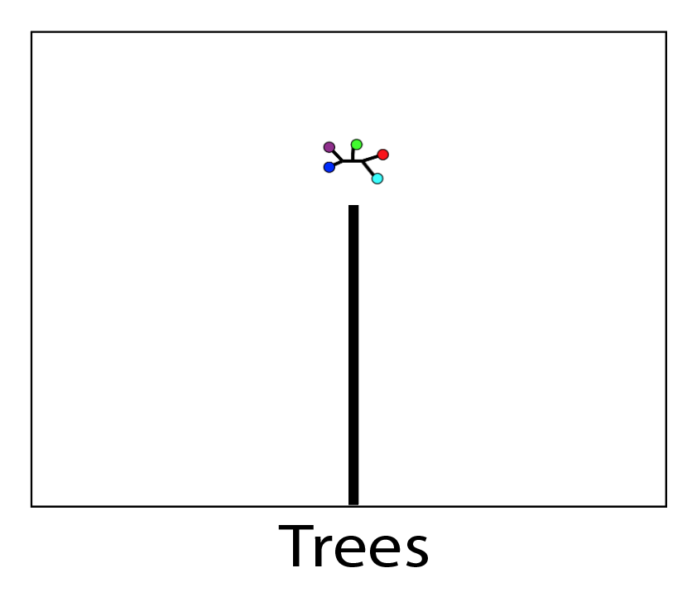
What is the point?
Theoretically, there is a point in ‘tree space’ that is the true history

Slide 3
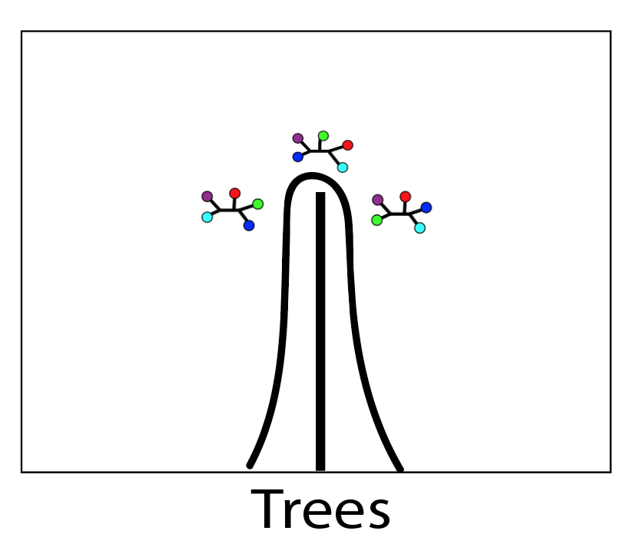
What is the point?
Variance due to our dataset hinders our ability to find it

Slide 4
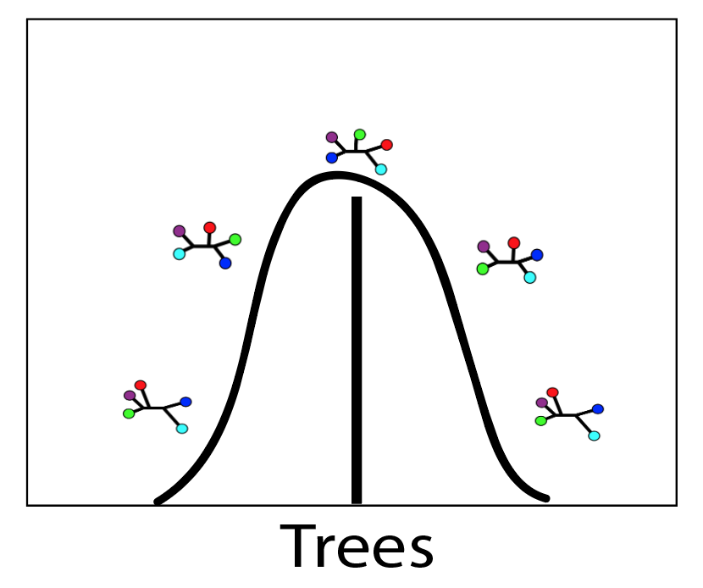
What is the point?
Variance due to our inference method, our model (=simplification)…

Slide 5
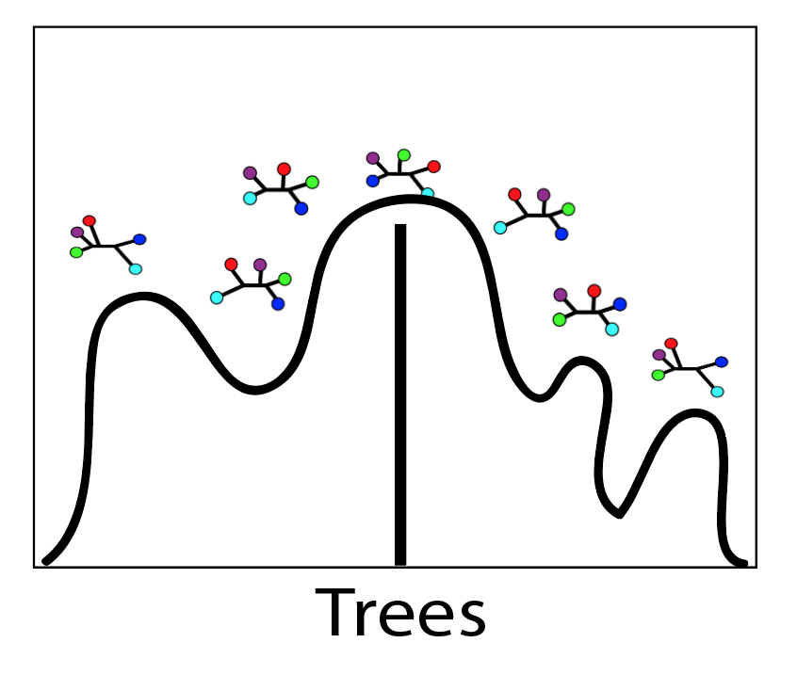
What is the point?
…This ‘landscape’ can become very complex.

Slide 6

ML: Searches tree space to maximize the quantity:
$$L=P\left(D | M\right)$$

Slide 7
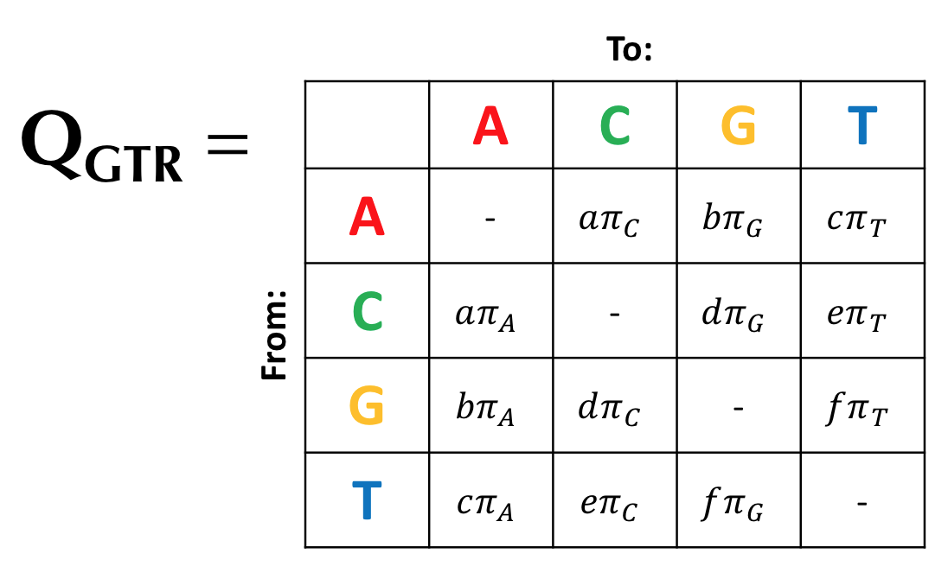
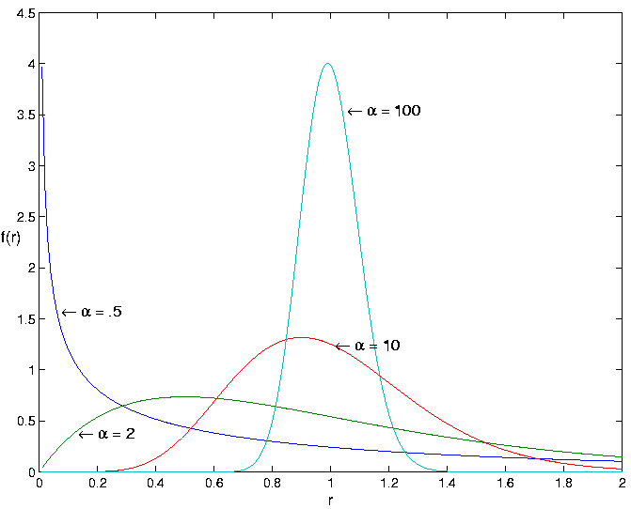
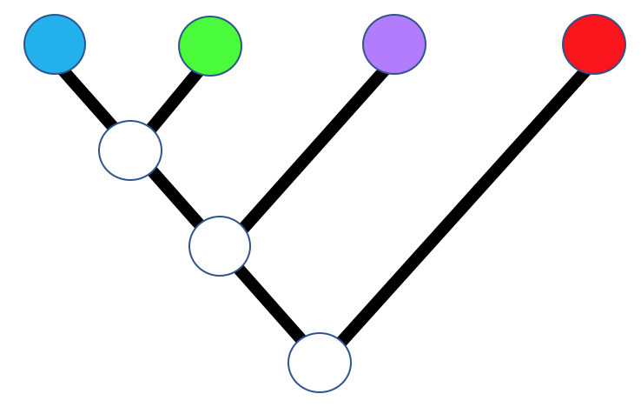
ML: Searches tree space to maximize the quantity:
$$L=P\left(D | M\right)$$

Slide 8
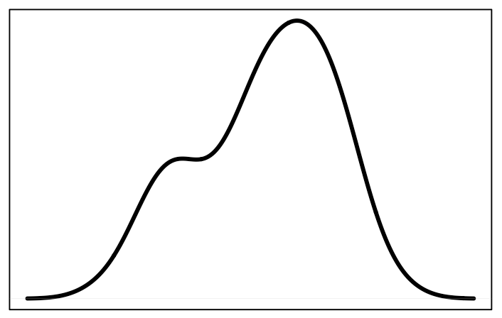
ML gives a point estimate
Maximum Likelihood Estimate
Frequency
Tree score

Slide 9
ML gives a point estimate
Maximum Likelihood Estimate
Frequency
Tree score
What about the variance around that estimate?

Slide 10
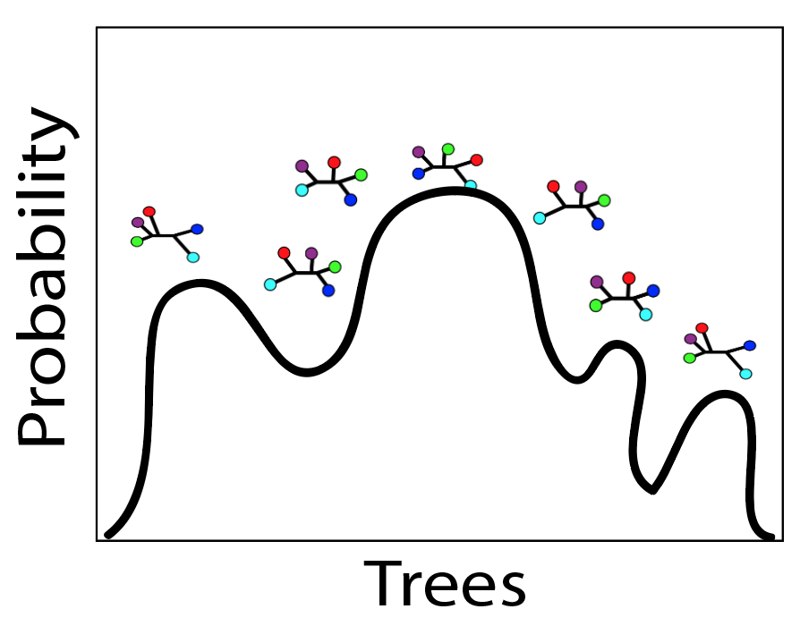
Solution?
Model tree space as a probability distribution
Consider variance in that distribution, not just find the ‘highest point’
Incorporate additional information to improve our inferences?

Slide 11
Thomas Bayes: (1701-1761)
Invented new branch of statistics in 1740s, and never published it (published posthumously in 1764)

Slide 12
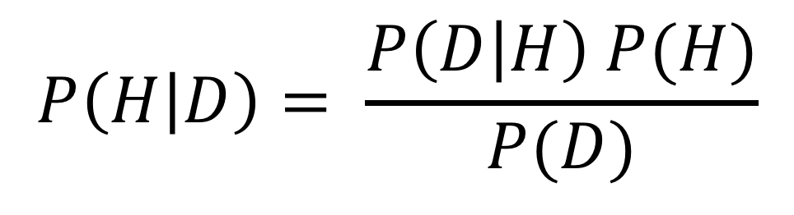
Bayes’ Theorem
$$P\left(H | D\right)= \frac{P\left(D | H\right) P(H)}{P(D)}$$

Slide 13
$$P\left(H | D\right)= \frac{P\left(D | H\right) P(H)}{P(D)}$$
“Posterior probability”: Probability of hypothesis (i.e. tree, model) given our data, and prior assumptions

Slide 14
“Likelihood”: Same as before, probability of the hypothesis producing our data
$$P\left(H | D\right)= \frac{P\left(D | H\right) P(H)}{P(D)}$$

Slide 15
“Prior probability”: Probability of our hypothesis before observing any data. Factor’s in preconceived beliefs about the likelihood of different hypotheses
$$P\left(H | D\right)= \frac{P\left(D | H\right) P(H)}{P(D)}$$

Slide 16
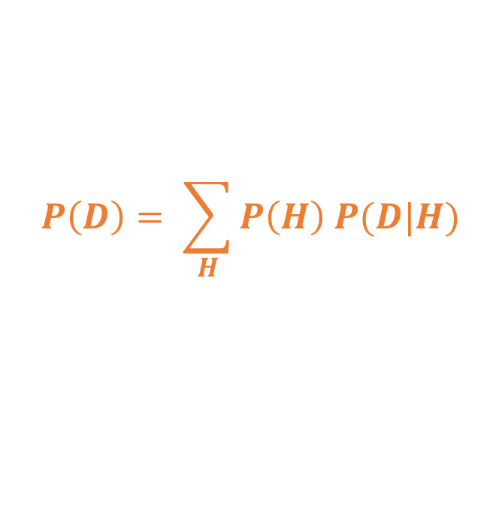
$$P\left(H | D\right)= \frac{P\left(D | H\right) P(H)}{P(D)}$$
“Marginal likelihood”: Normalizing constant to make sure the posterior sums to 1. Takes the form:
$$P\left(D\right)= \sum_{H}{P\left(H\right) P(D|H)}$$

Slide 17
Important concepts
Prior probability: Probability of an event before considering the data
What do we know about how branch lengths are distributed?
What do we know about mutations rates?
How are speciation/extinction rates distributed?

Slide 18
Important concepts
Prior probability: Probability of an event before considering the data
What do we know about how branch lengths are distributed?
What do we know about mutations rates?
How are speciation/extinction rates distributed?
Posterior probability: Probability of an event after taking data and priors into consideration
Given our prior expectations, and the likelihood of our data given the hypothesis, what is the probability of the hypothesis?

Slide 19
Bayesian stats example
Let’s say you’ve tested positive for some imaginary disease. What is the probability you have the disease, given:
0.1% of people have the disease
1% false positive rate of the test

Slide 20
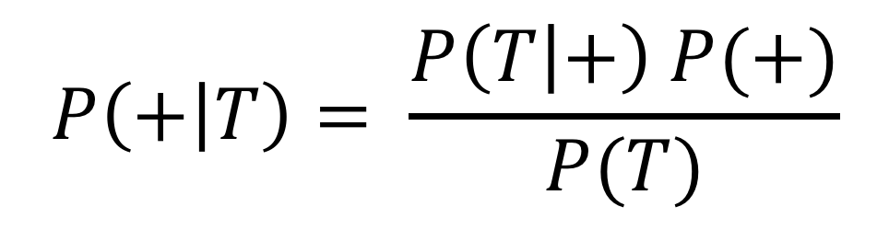
Bayesian stats example
What we want: Probability of having the disease (+), given that you tested positive (T)
$$P\left(+ | T\right)= \frac{P\left(T | +\right) P(+)}{P(T)}$$

Slide 21
Bayesian stats example
Probability of testing positive, given that you are actually positive (in other words: What is the true positive rate of the test?)
$$P\left(+ | T\right)= \frac{P\left(T | +\right) P(+)}{P(T)}$$
The test has a 1% false positive rate. So, we assume the test has a 99% true positive rate.

Slide 22
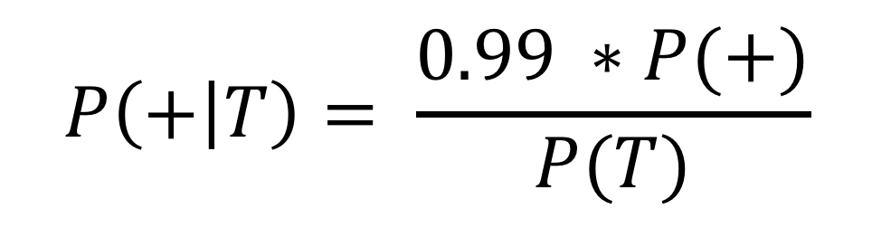
Bayesian stats example
Probability of testing positive, given that you are actually positive (in other words: What is the true positive rate of the test?)
$$P\left(+ | T\right)= \frac{0.99 ∗P(+)}{P(T)}$$
What we know: The test has a 1% false positive rate. So, we assume the test has a 99% true positive rate.

Slide 23
Bayesian stats example
Probability of having the disease, without considering the test results (this is the prior probability!)
$$P\left(+ | T\right)= \frac{0.99 ∗P(+)}{P(T)}$$
What we know: 0.1% of the population has the disease.

Slide 24
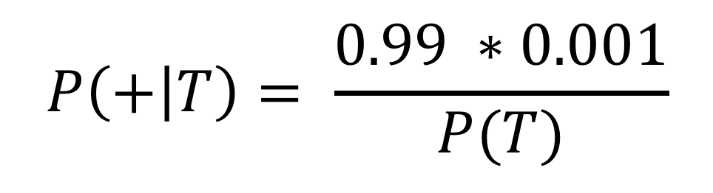
Bayesian stats example
Probability of having the disease, without considering the test results (this is the prior probability!)
$$P\left(+ | T\right)= \frac{0.99 ∗0.001}{P(T)}$$
What we know: 0.1% of the population has the disease.

Slide 25
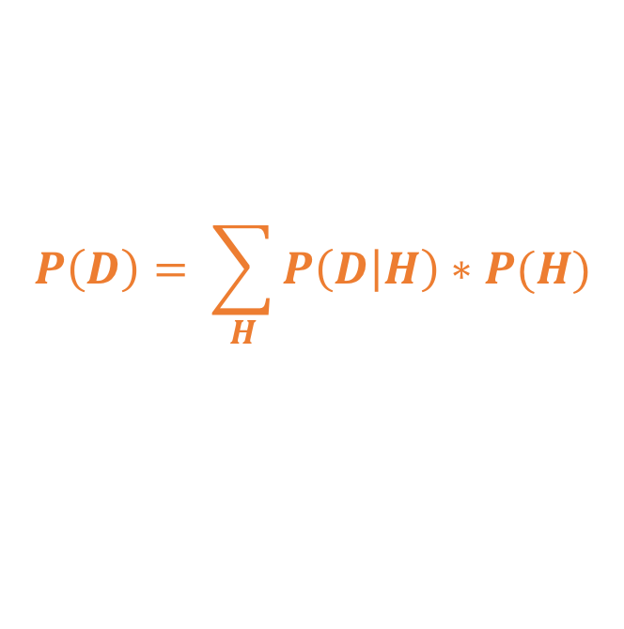
Bayesian stats example
$$P\left(+ | T\right)= \frac{0.99 ∗0.001}{P(T)}$$
Marginal likelihood:
$$P\left(D\right)= \sum_{H}{P\left(D | H\right)∗P(H)}$$

Slide 26

Bayesian stats example
$$P\left(D\right)= \sum_{H}{P\left(D | H\right)∗P(H)}$$
This is the sum of P(H)*P(D|H) for all hypotheses (i.e. all values of H)

Slide 27
Bayesian stats example
$$P\left(D\right)= \sum_{H}{P\left(D | H\right)∗P(H)}$$
This is the sum of P(H)*P(D|H) for all hypotheses (i.e. all values of H)
There are only two hypotheses: Having disease (+) or not (-), so:
$P\left(D\right)=\left[P\left(T | +\right)P\left(+\right)\right]+$ $\left[P\left(T | −\right)P(−)\right]$

Slide 28
Bayesian stats example
Prob of testing positive given that you have the disease (0.99)
$P\left(D\right)=\left[P\left(T | +\right)P\left(+\right)\right]+$ $\left[P\left(T | −\right)P(−)\right]$
Prob of having the disease (=0.001)

Slide 29
Bayesian stats example
Prob of testing positive given that you have the disease (0.99)
$P\left(D\right)=\left[0.99∗0.001\right]+$ $\left[P\left(T | −\right)P(−)\right]$
Prob of having the disease (=0.001)

Slide 30
Bayesian stats example
Prob of testing positive given that you don’t have the disease (i.e. probability of a false positive) = 1%
$P\left(D\right)=\left[0.99∗0.001\right]+$ $\left[P\left(T | −\right)P(−)\right]$
Prob of not having the disease
0.1% of population have disease
so 99.9% don’t

Slide 31
Bayesian stats example
Prob of testing positive given that you don’t have the disease (i.e. probability of a false positive) = 1%
$P\left(D\right)=\left[0.99∗0.001\right]+$ $\left[0.01∗.999\right]$
Prob of not having the disease
0.1% of population have disease
so 99.9% don’t

Slide 32

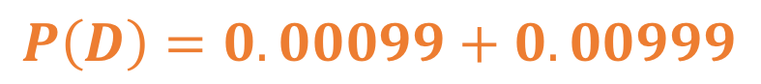
Bayesian stats example
Doing some math…
$P\left(D\right)=0.00099+$ $0.00999$
$$P\left(D\right)=0.01098$$

Slide 33

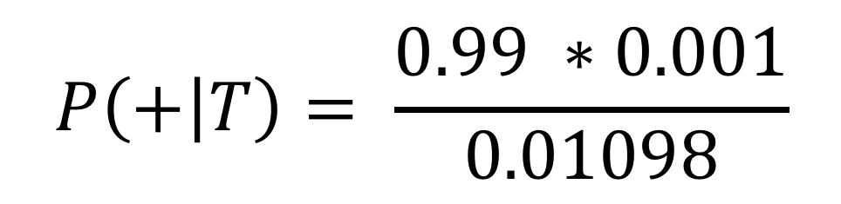
Bayesian stats example
$$P\left(+ | T\right)= \frac{0.99 ∗0.001}{0.01098}$$
$$P\left(+ | T\right)=0.09$$
~10% probability you have the disease, given that you have tested positive

Slide 34
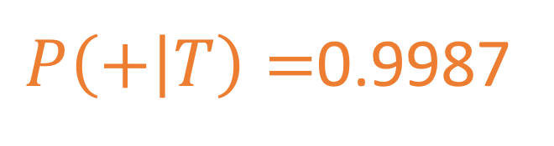
Bayesian stats example
Why?
Relatively high false positive rate
Disease extremely rare
Tests are NOT the event!
With more realistic numbers: HIV in U.S
HIV test ~0.0004% false positive rate
0.3% of US population has HIV
$P\left(+ | T\right)=$0.9987

Slide 35
The power of priors!
With priors, we can:
Incorporate additional information
Make our assumptions explicit

Slide 36
The power of priors!
BUT, we can also:
Dominate the posterior probability when there is little signal in our data
Bias the result when we mis-specify our priors
Over-express our confidence in our prior expectations
Make reviewers mad

Slide 37
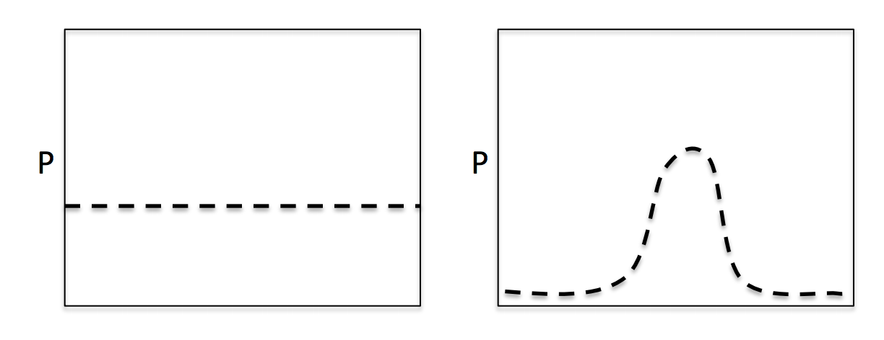
Priors in practice
BUT, we can also:
Often are provided as distributions
Can be informative or uninformative (reflecting how much we know)

Slide 38
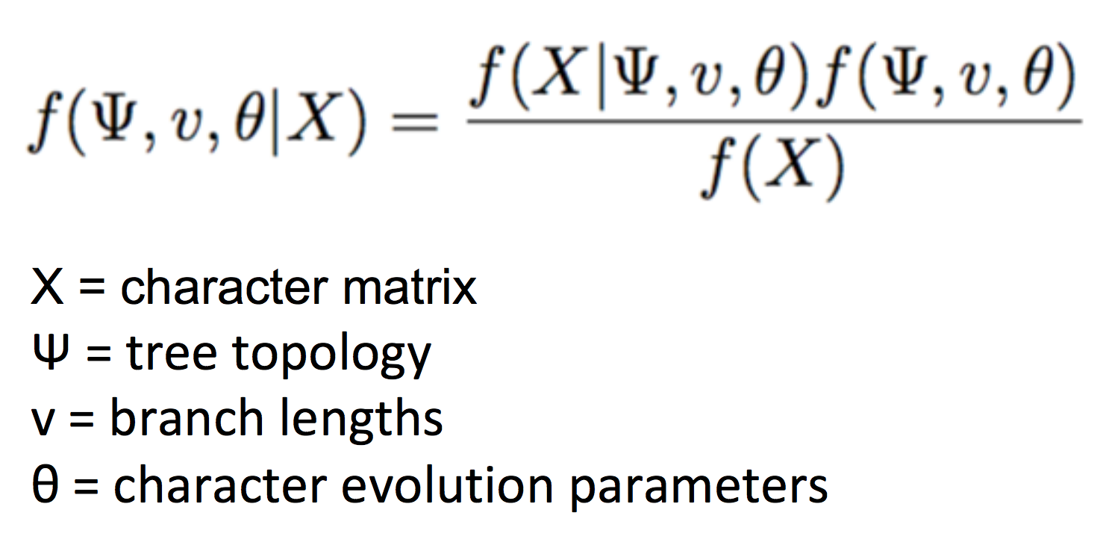
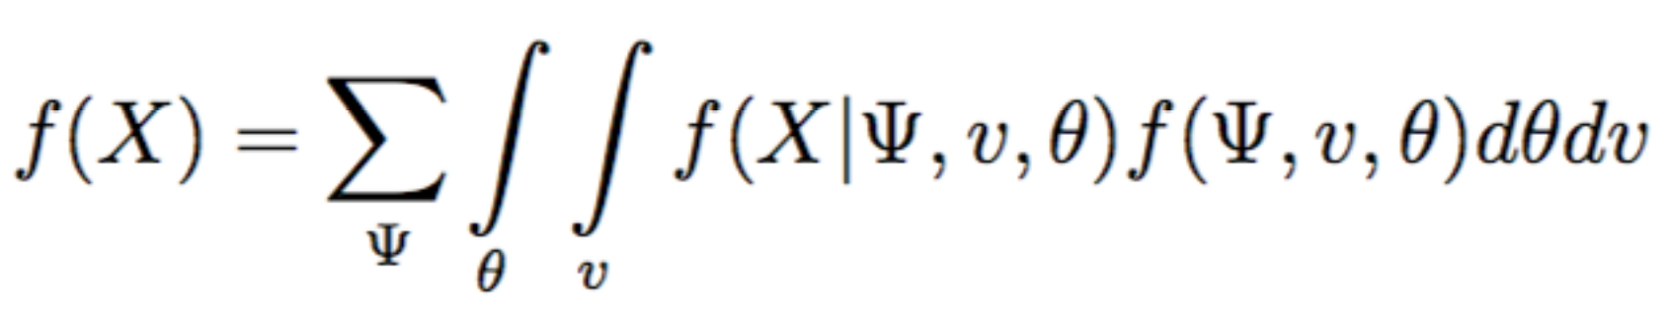
Bayes Theorem in Phylogenetics

Slide 39
Bayes Theorem in Phylogenetics
Pretty complicated…
We can’t directly solve this analytically
Instead, we model it as a probability distribution
To do this, we use a method called Markov Chain Monte Carlo

Slide 40
Markov Chain Monte Carlo (MCMC)
Family of sampling algorithms used to approximate a probability distribution
Simulates a “walk” through parameter space
Markov chain = A memoryless process
Monte Carlo = simulation based on random sampling

Slide 41
MCMC Method
Start at some value for parameter 𝜃
Sample a new value 𝜃’ (from a prior!)
Calculate probability ratio (R)
If R >= 1: Keep new value 𝜃’
If R < 1, draw a random number 0≤𝛼≤1. If 𝛼 > R, throw away 𝜃’
Return to step 2 for next iteration
Repeat a few hundred thousand times…

Slide 42
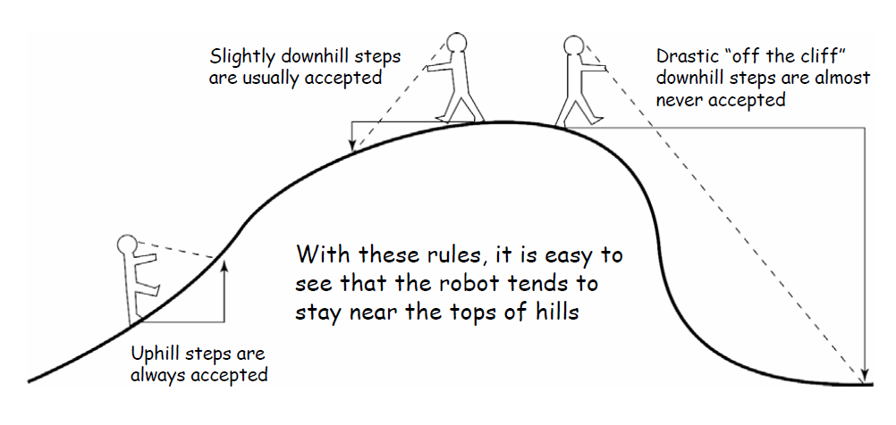
MCMC “Robot” Metaphor

Slide 43
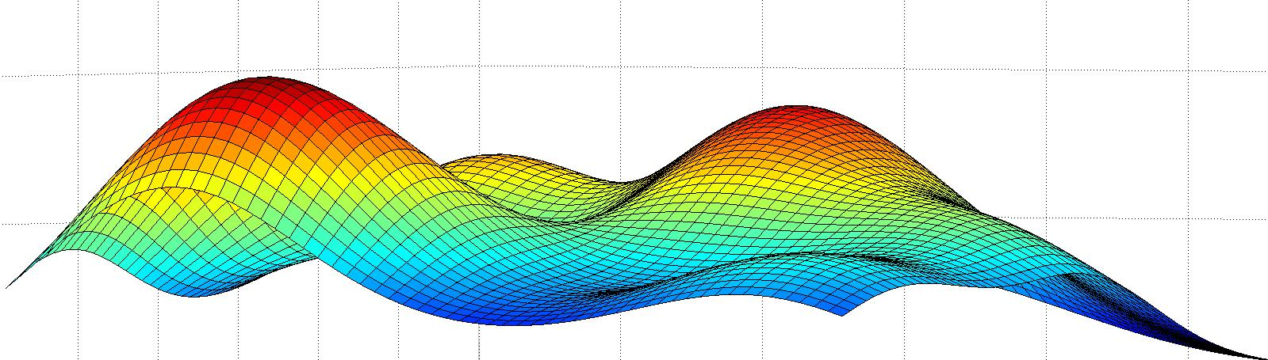
Sampling parameter space
Different starting points can lead to different answers
MCMC “chain” can get stuck on local peaks
Hopefully this sounds familiar

Slide 44
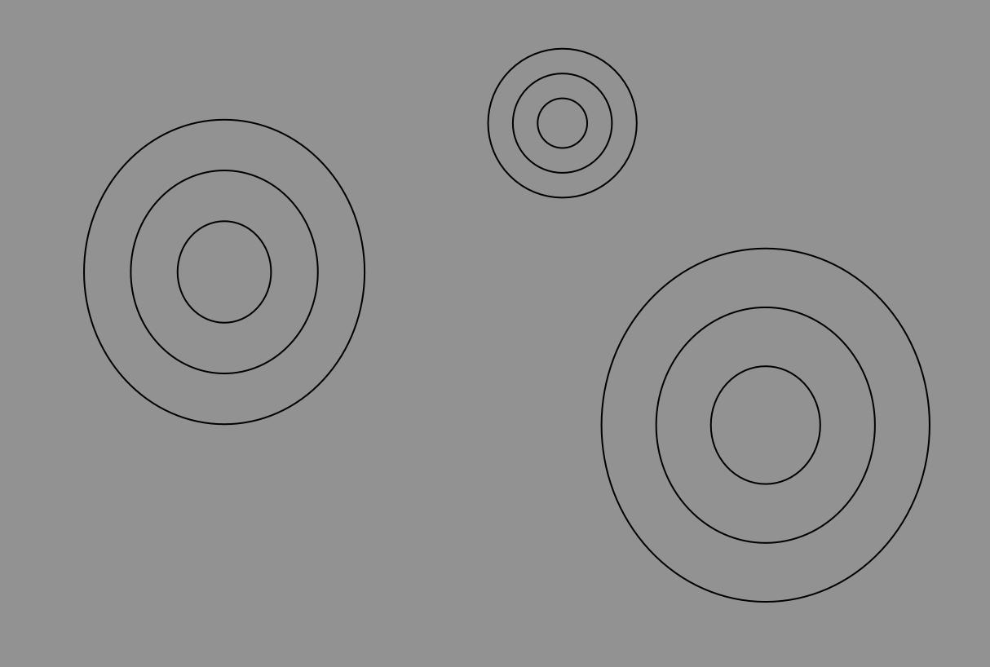

Slide 45
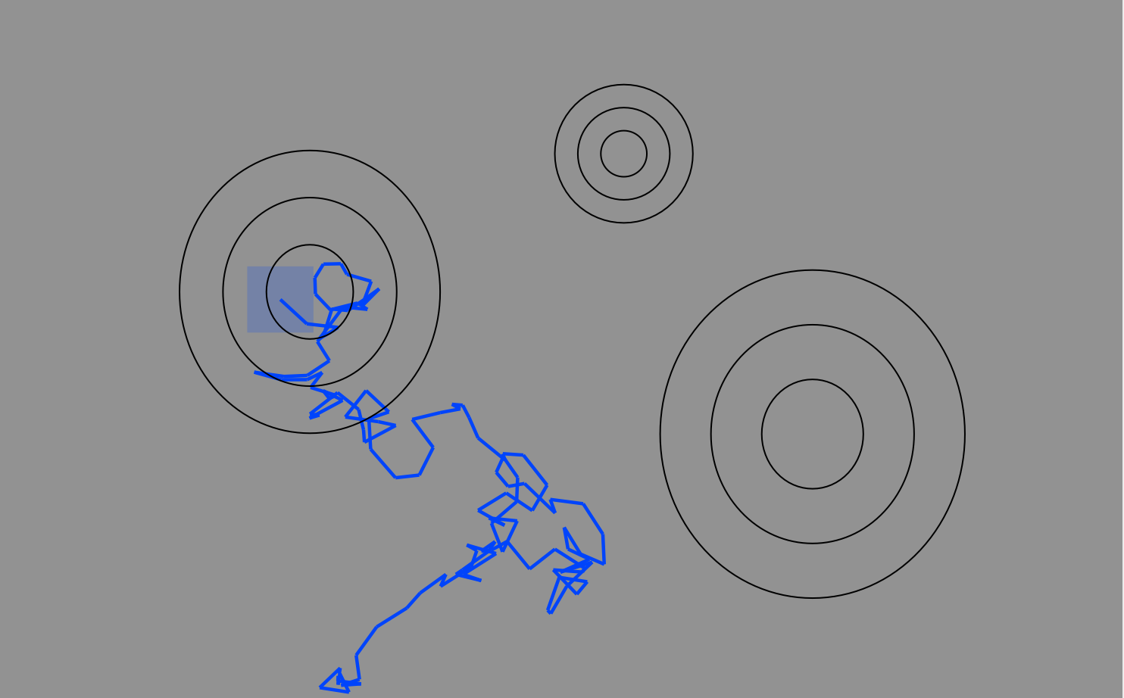
It sometimes takes a while for the “MCMC Robot” to find the hill to climb… These samples likely do not approximate the posterior, so we discard them as “burn-in”

Slide 46
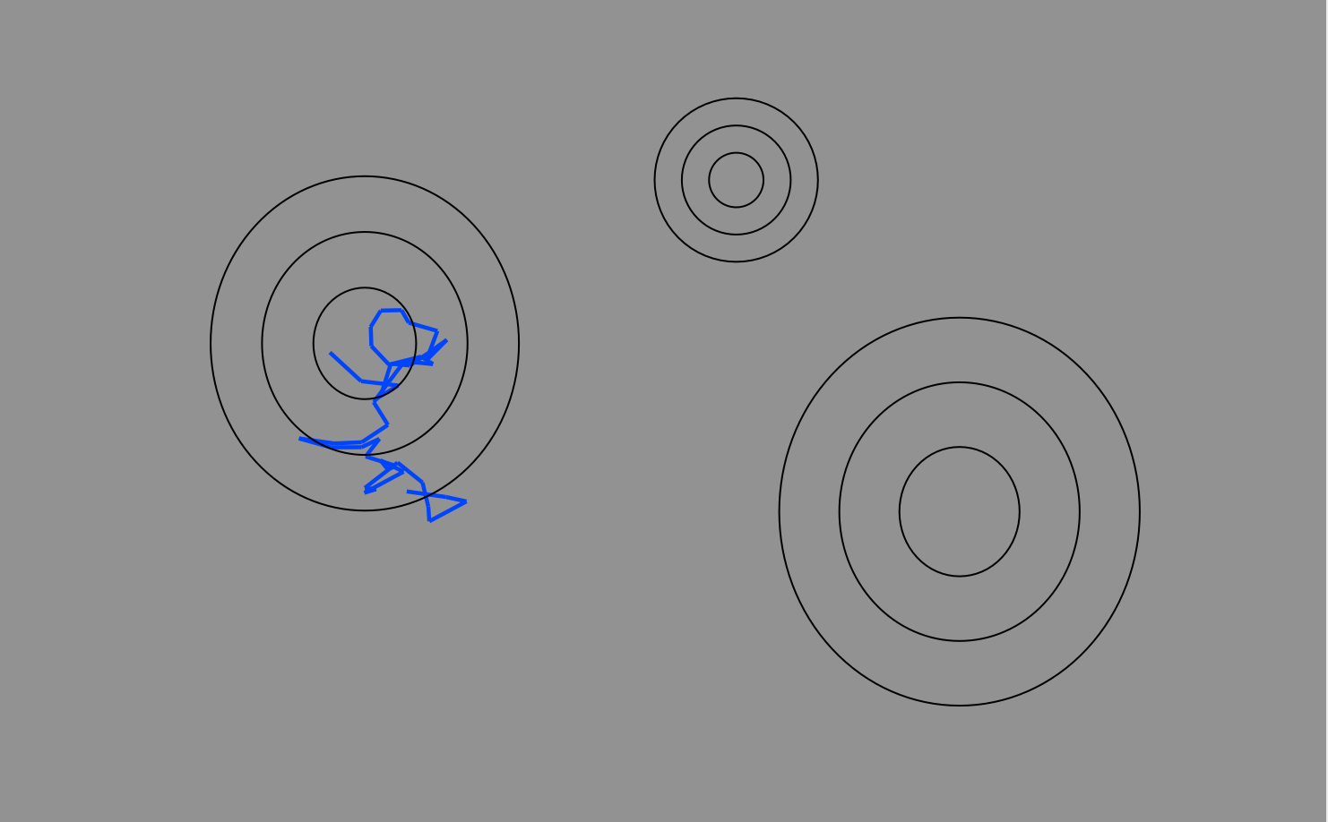
It sometimes takes a while for the “MCMC Robot” to find the hill to climb… These samples likely do not approximate the posterior, so we discard them as “burn-in”

Slide 47
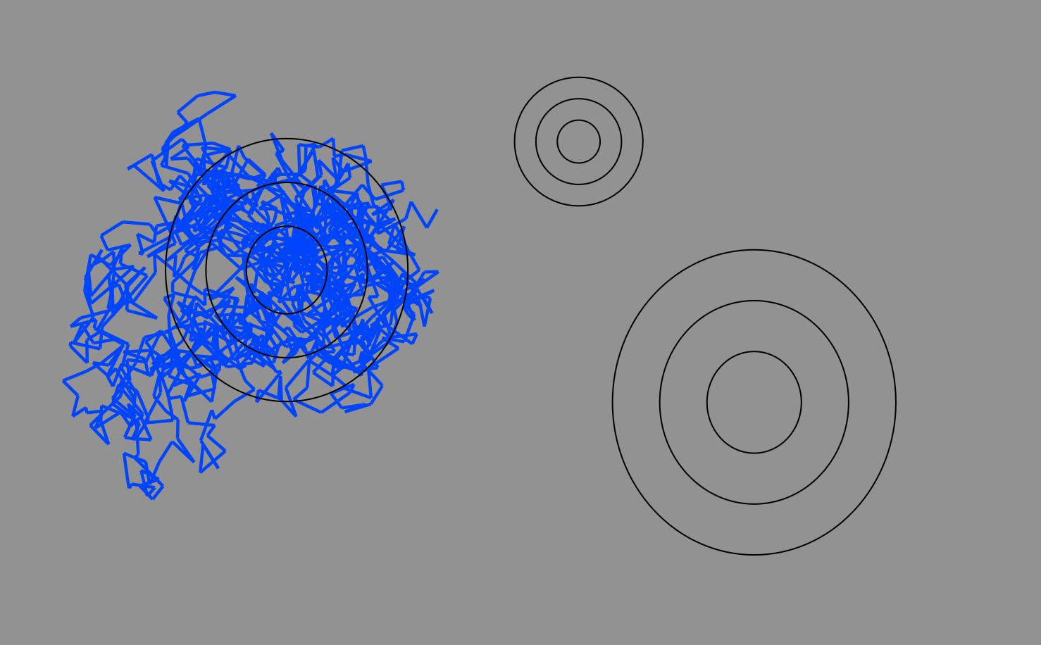
Continued sampling explores peaks in parameter space.

Slide 48
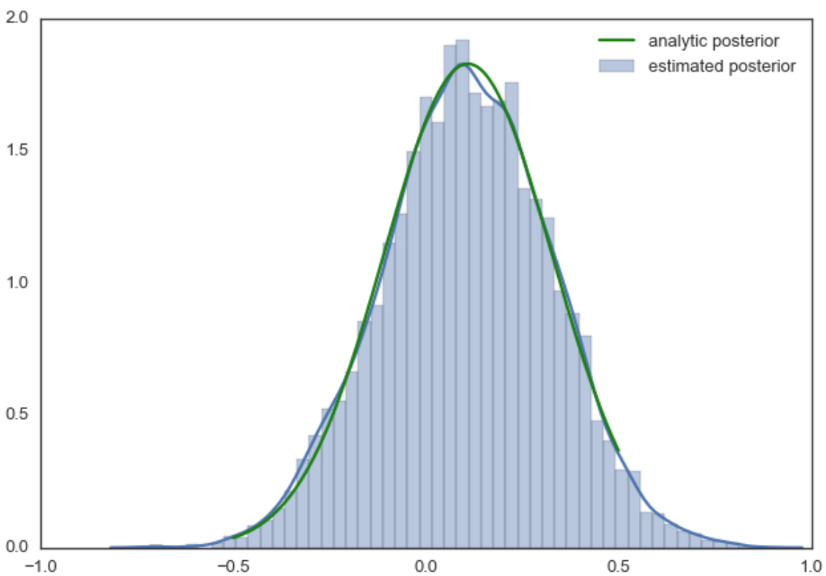
The ‘samples’ taken from these data points is assumed to approximate the posterior, giving us a distribution of results proportional to the posterior probability distribution.

Slide 49
Oh no! We’re stuck on a local optimum! What about the rest of parameter space??

Slide 50
Metroupolis-coupled MCMC
Adds additional chains which act as “scouts”
Scouts (called “heated” chains) explore a flattened landscape
Occasionally (e.g. every 1000 iterations), we check if heated chains found a better peak. If yes, they swap states

Slide 51
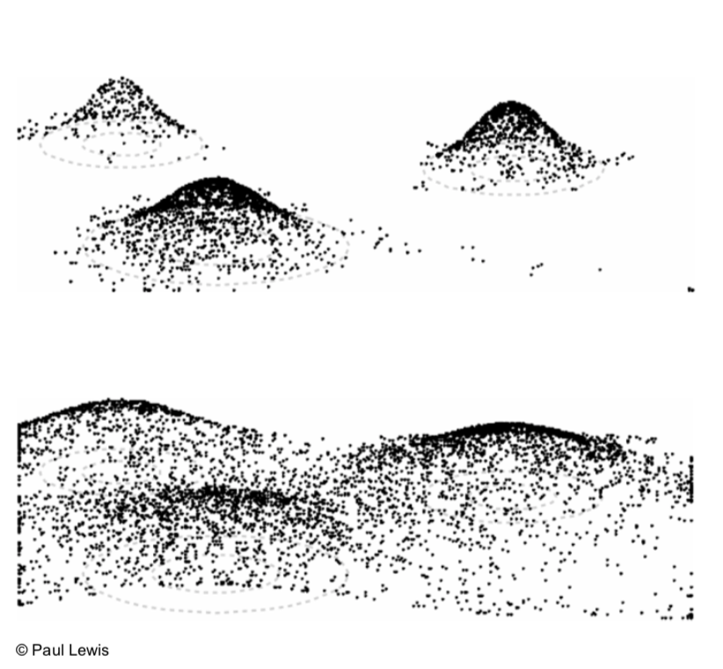
Metroupolis-coupled MCMC
Cold landscape: Peaks separated by deep valleys- hard for hill climbing robot to cross
Heated landscape: Flattened and shallow (easy to cross) valleys

Slide 52
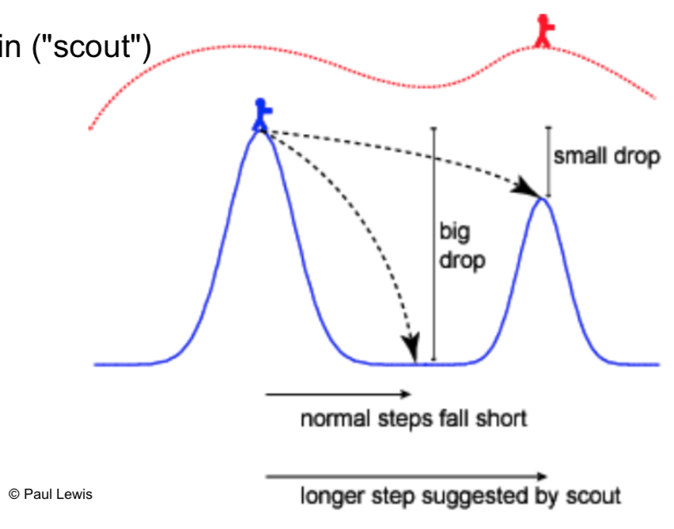
Metroupolis-coupled MCMC

Slide 53
Assessing MCMC Sampling
Burn-in
Throw out samples taken prior to convergence
Convergence = sampling approximately around the same point
Mixing
How efficient is your sampling – is the chain stuck sampling the same place for long periods of time?
Consistency
Are independent runs finding the same result?

Slide 54
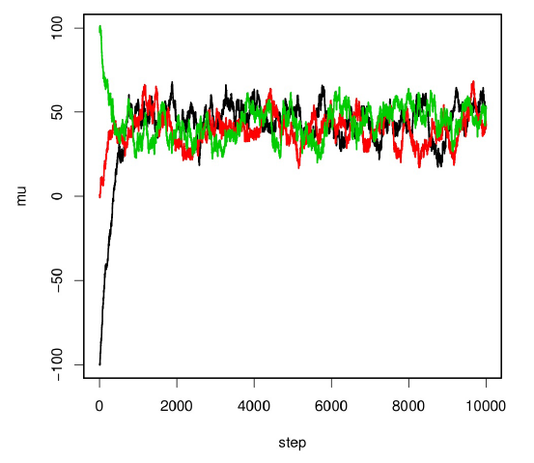
Assessing MCMC Sampling
Remove trees sampled while chain is trying to “find” regions of high probability
This is “burn-in”

Slide 55
Assessing MCMC Sampling
Burn-in
Throw out samples taken prior to convergence
Convergence = sampling approximately around the same point
Mixing
How efficient is your sampling – is the chain stuck sampling the same place for long periods of time?
Consistency
Are independent runs finding the same result?

Slide 56
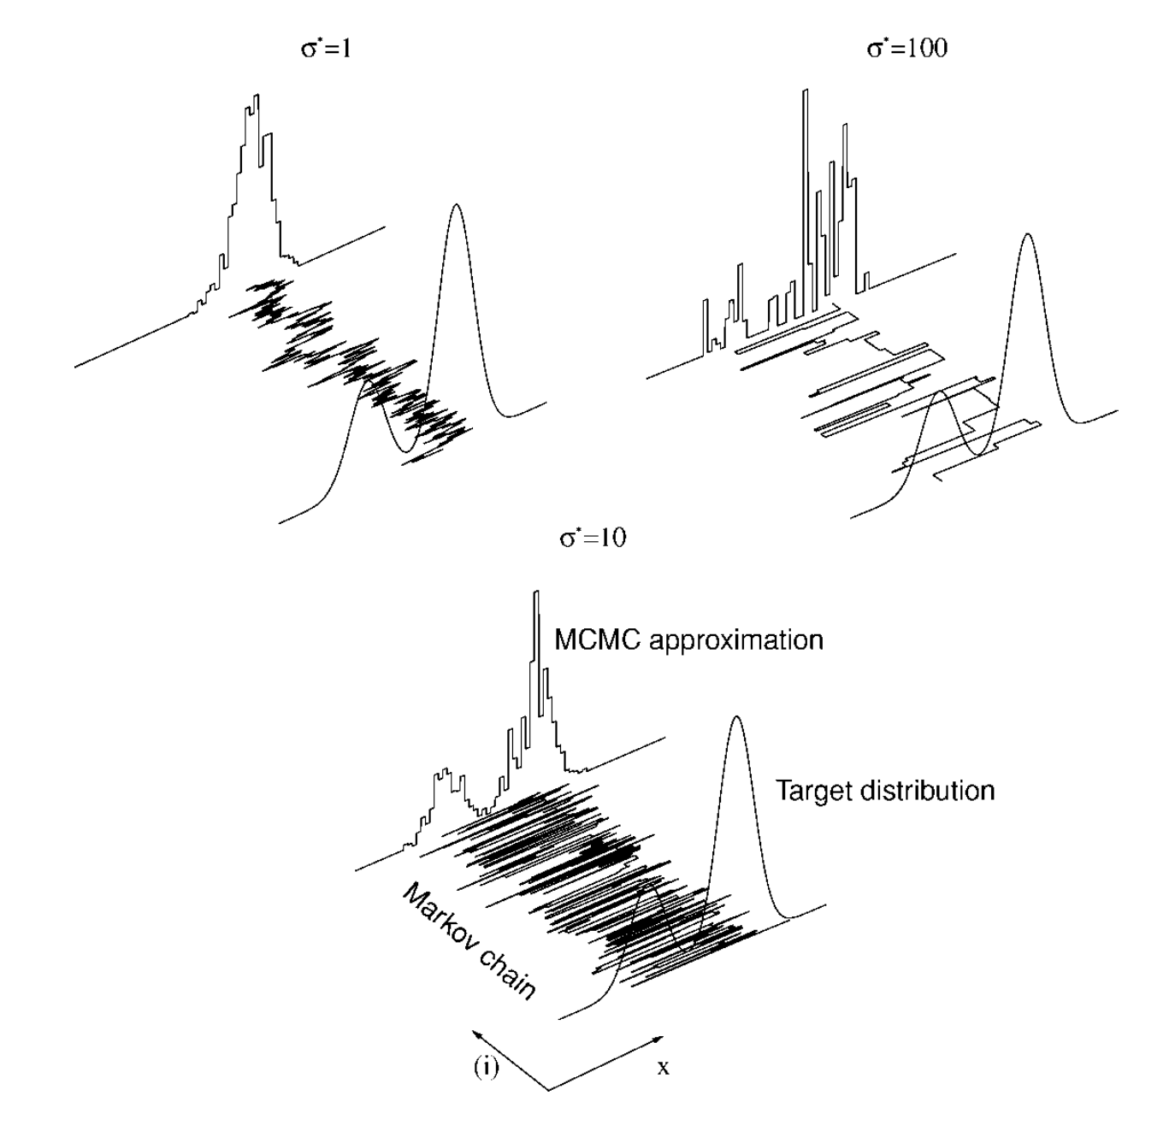
Assessing MCMC Sampling
Do our samplings approximate the posterior?
Stuck sampling the same place for a long time?
Bouncing around too erratically?

Slide 57
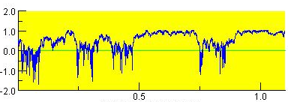
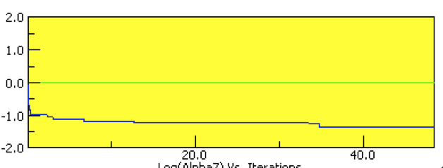
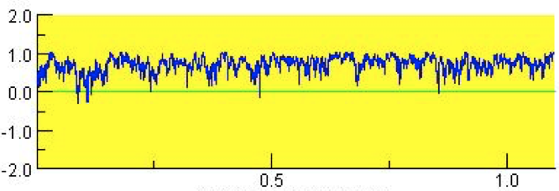
Assessing MCMC Sampling
Bouncing around erratically! 🤬
Stuck in the same place! 🤬
Good mixing 😀

Slide 58
What to do about bad mixing?
Adjust “step size”, or how different proposed steps are.
Proposed steps can’t be too similar or too different
Felsenstein: “At the moment the choice of a good proposal distribution involves the burning of incense, casting of chicken bones, use of magical incantations, and invoking the opinions of more prestigious colleagues.
Thinning samples
For example, only record every 1,000th tree instead of every 100th
Will need to run MCMC longer..

Slide 59
Assessing MCMC Sampling
Burn-in
Throw out samples taken prior to convergence
Convergence = sampling approximately around the same point
Mixing
How efficient is your sampling – is the chain stuck sampling the same place for long periods of time?
Consistency
Are independent runs finding the same result?

Slide 60
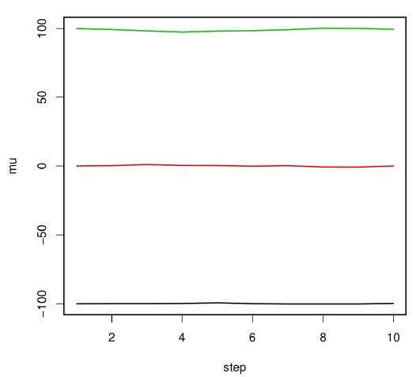
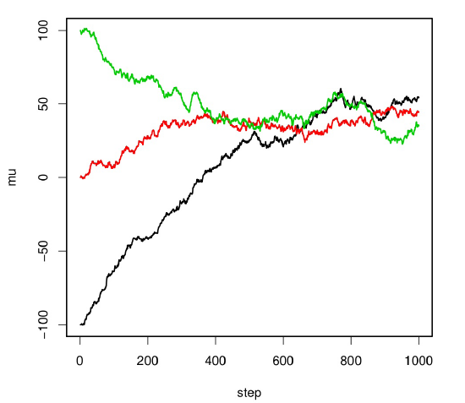
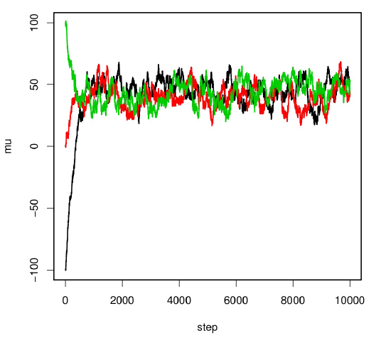
Convergence
Use different starting points (trees)
MrBayes takes care of this for you…
If independent runs produce consistent results, your chains have probably reached convergence

Slide 61
What now??

Slide 62
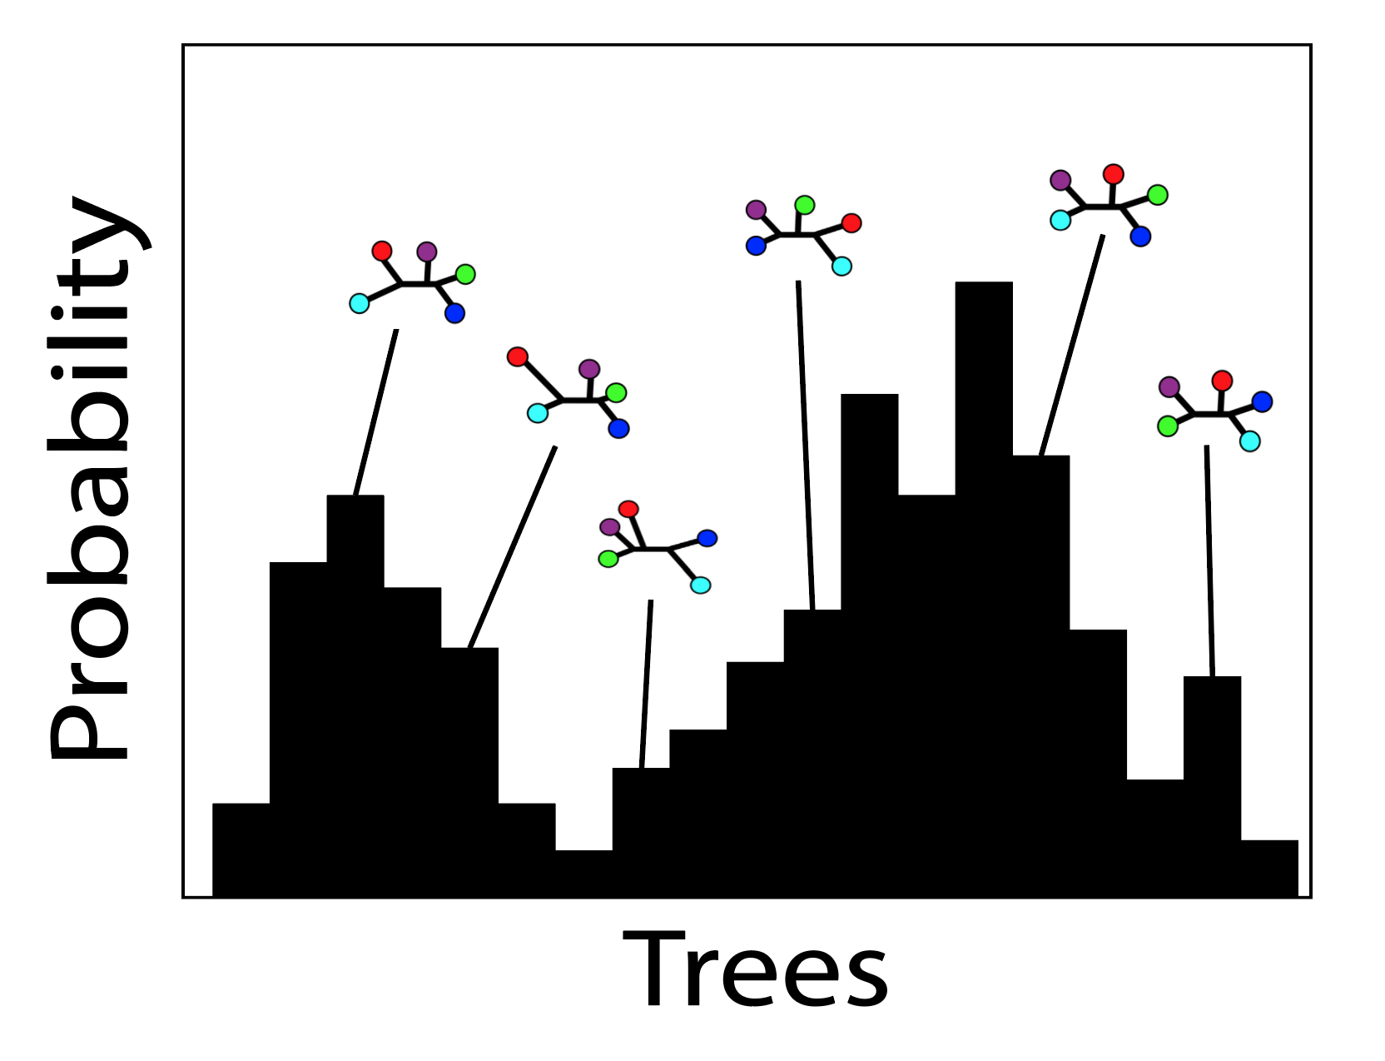
Result: A distribution of trees

Slide 63
Summarizing the distribution
87
99
98
100
Node supports represent posterior probabilities: How many posterior trees agree with that node?

Slide 64
MrBayes – Basic Work Flow
Set up short exploratory analyses to:
Determine burn-in
Assess convergence
Set up the “real” analysis using results of your exploratory analyses
Run for a much longer period of time
Potentially a million or more generations
Double-check that convergence occurred
Go back to the drawing board as necessary

